Slide 1
Representation of Algorithm and Flowchart
Prepared By:
Asst. Prof. Jyotsnarani Tripathy

Slide 2
Algorithms
An algorithm is a step-by-step procedure for
solving a problem in a finite amount of time.
An algorithm is a procedure (a finite set of well-defined instructions) for accomplishing some tasks which,
given an initial state
terminate in a defined end-state

Slide 3
Cont..
The word “algorithm” relates to the name of the mathematician Al-khowarizmi, which means a procedure or a technique
An algorithm is a sequence of steps to solve a particular problem or algorithm is an ordered set of unambiguous steps that produces a result and terminates in a finite time

Slide 4
Cont..
Algorithm has the following characteristics
Input: An algorithm may or may not require input
Output: Each algorithm is expected to produce at least one result
Definiteness: Each instruction must be clear and unambiguous.
Finiteness: If the instructions of an algorithm are executed,
the algorithm should terminate after finite number of steps

Slide 5
Cont..
The algorithm and flowchart include following three types of control structures.
Sequence: In the sequence structure, statements are placed one after the other and the execution takes place starting from up to down.
Branching (Selection): In branch control, there is a condition and according to a
condition, a decision of either TRUE or FALSE is achieved. In the case of TRUE, one of the two branches is explored; but in the case of FALSE condition, the other alternative is taken. Generally, the ‘IF-THEN’ is used to represent branch control.
Loop (Repetition): The Loop or Repetition allows a statement(s) to be executed repeatedly based on certain loop condition e.g. WHILE, FOR loops.

Slide 6
Advantages of algorithm
It is a step-wise representation of a solution to a given problem, which makes it easy to understand.
An algorithm uses a definite procedure.
It is not dependent on any programming language, so it is easy to understand for anyone even without programming knowledge.
Every step in an algorithm has its own logical sequence so it is easy to debug.

Slide 7
FLOWCHART
The first design of flowchart goes back to 1945 which was designed by John Von Neumann.
Unlike an algorithm, Flowchart uses different symbols to design a solution to a problem. It is another commonly used programming tool.
By looking at a Flowchart one can understand the operations and sequence of operations performed in a system.
Flowchart is often considered as a blueprint of a design used for solving a specific problem.

Slide 8
Flowchart
Flowchart is diagrammatic /Graphical representation of sequence of steps to solve a problem.
To draw a flowchart following standard symbols are use

Slide 9
Advantages of flowchart
Flowchart is an excellent way of communicating the logic of a program.
Easy and efficient to analyze problem using flowchart.
During program development cycle, the flowchart plays the role of a blueprint, which makes program development process easier.
After successful development of a program, it needs continuous timely maintenance during the course of its operation. The flowchart makes program or system maintenance easier.
It is easy to convert the flowchart into any programming language code.

Slide 10

Symbol Name | Symbol | function
Oval |  | Used to represent start and end of flowchart
Parallelogram |  | Used for input and output operation
Rectangle |  | Processing: Used for arithmetic operations and data-manipulations
Diamond |  | Decision making. Used to represent the operation in which there are two/three alternatives, true and false etc
Arrows |  | Flow line Used to indicate the flow of logic by connecting symbols
Circle |  | Page Connector
 |  | Off Page Connector
 |  | Predefined Process /Function Used to represent a group of statements performing one processing task.
 |  | Preprocessor
 | |-------------- --------- | |-------------- | Comments

Slide 11
Algorithm & Flowchart to find the sum of two numbers
Algorithm
Step-1 Start
Step-2 Input first numbers say A
Step-3 Input second number say B
Step-4 SUM = A + B
Step-5 Display SUM
Step-6 Stop

Slide 12
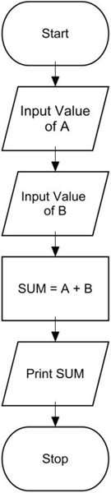
Flowchart

Slide 13
Algorithm/Flowchart to convert temp from Celsius to Fahrenheit
C : temperature in Celsius F : temperature Fahrenheit
Algorithm
Step-1 Start
Step-2 Input temperature in Celsius say C Step-3 F = (9.0/5.0 x C) + 32
Step-4 Display Temperature in Fahrenheit F Step-5 Stop

Slide 14
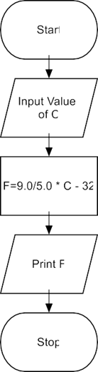
Flowchart

Slide 15
Algorithm & Flowchart to find Area and Perimeter of Square
L : Side Length of Square AREA : Area of Square
PERIMETER : Perimeter of Square
Algorithm
Step-1 Start
Step-2 Input Side Length of Square say L
Step-3 Area = L x L
Step-4 PERIMETER = 4 x L
Step-5 Display AREA, PERIMETER
Step-6 Stop

Slide 16
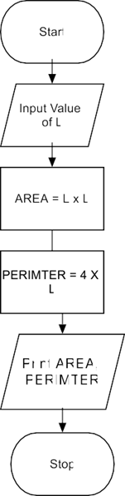
Flowchart

Slide 17
Algorithm & Flowchart to find Area & Perimeter of Triangle
A : First Side of Triangle
B : Second Side of Triangle C : Third Side of Triangle AREA : Area of Triangle
PERIMETER : Perimeter of Triangle
Algorithm
Step-1 Start
Step-2 Input Sides of Triangle A,B,C
Step-3 S= (A + B + C)/ 2.0
Step-4 AREA = SQRT(S x (S-A) x (S-B) x(S-C))
Step-5 PERIMETER = S1 + S2 + S3
Step-6 Display AREA, PERIMETER
Step-7 Stop

Slide 18
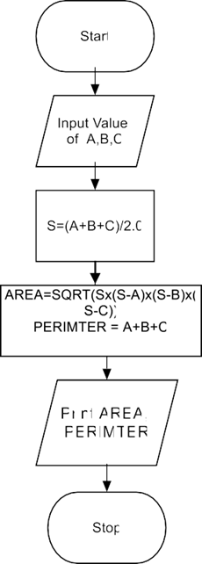
Flowchart

Slide 19
Algorithm & Flowchart to find Simple Interest
P : Principle Amount N : Time in Years
R : % Annual Rate of Interest SI : Simple Interest
Algorithm
Step-1 Start
Step-2 Input value of P, N, R
Step-3 SI = (P x N x R)/100.0
Step-4 Display SI
Step-6 Stop

Slide 20
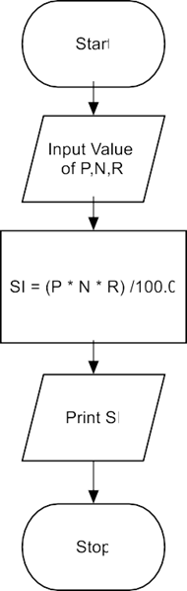
Flowchart

Slide 21
Algorithm & Flowchart to find Compound Interest
P : Principle Amount
N : Time in Years
R : % Annual Rate of Interest
CI : Compound Interest
Algorithm
Step-1 Start
Step-2 Input value of P, N, R C
Step-3 CI = P(1+R/100)^{N} - P
Step-4 Display CI
Step-6 Stop

Slide 22
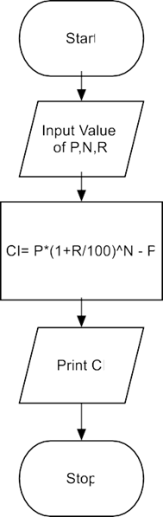
Flowchart

Slide 23
Algorithm & Flowchart to Swap Two Numbers using Temporary Variable
Algorithm
Step-1 Start
Step-2 Input Two Numbers Say NUM1,NUM2
Step-3 Display Before Swap Values NUM1 NUM2
Step-4 TEMP = NUM1
Step-5 NUM1 = NUM2
Step-6 NUM2 = TEMP
Step-7 Display After Swap Values NUM1,NUM2 Step-8 Stop

Slide 24
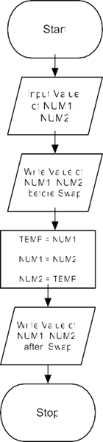
Flowchart

Slide 25
Algorithm & Flowchart to Swap Two Numbers without using temporary variable
Algorithm
Step-1 Start
Step-2 Input Two Numbers Say A,B Step-3 Display Before Swap Values A, B
Step-4 A = A + B Step-5 B = A - B Step-6 A = A - B
Step-7 Display After Swap Values A, B Step-8 Stop

Slide 26
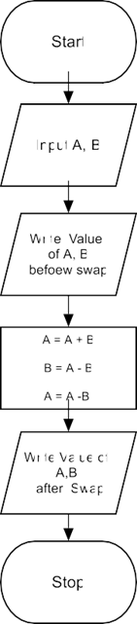
Flowchart

Slide 27
Algorithm & Flowchart to find out largest among two Variable
Algorithm
Step-1 Start
Step-2 Read a, b
Step-3 If a>b then
Step-4 Display “a is the largest number”
Step-5 Display “b is the largest number”
Step-6 End

Slide 28
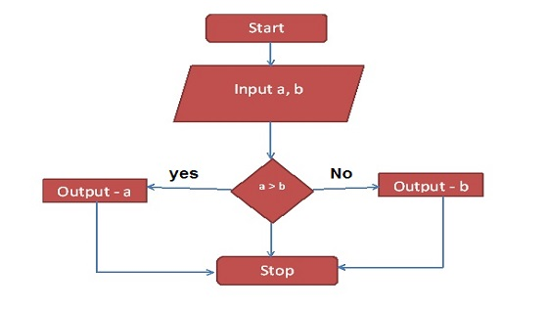
Flow Chart

Slide 29
Algorithm & Flowchart to find out largest among three Variable
Algorithm
Step 1 : Start.
Start 2 : Input A, B, C.
Start 3 : Let max = A.
Start 4 : if B > max then max = B.
Start 5 : if C > max then max = C.
Start 6 : Output max is largest.
Start 7 : Stop.

Slide 30
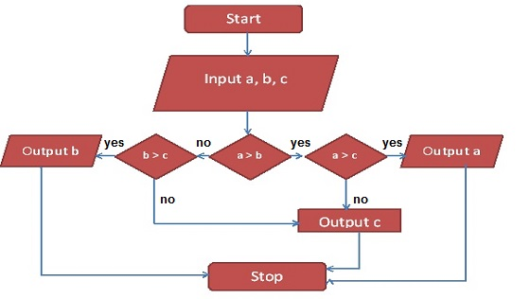
Flow Chart

Slide 31
Algorithm & Flowchart to print 1 to 20
Step 1: Start
Step 2: Initialize variable number as integernumber (n) = 1
Step 3: Read and print the value of number
Step 4: Repeat the step 3 until number < 20
number = number (n) + 1
Step 5: Stop

Slide 32
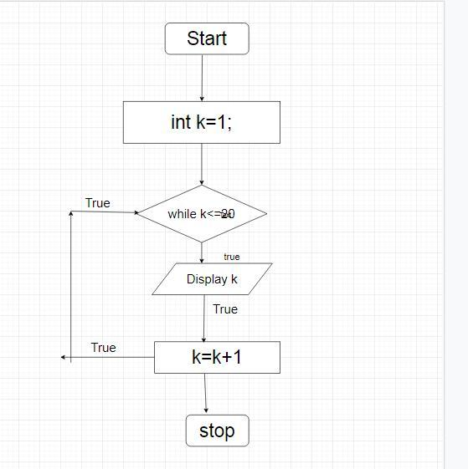
Flow chart

